Slide 1
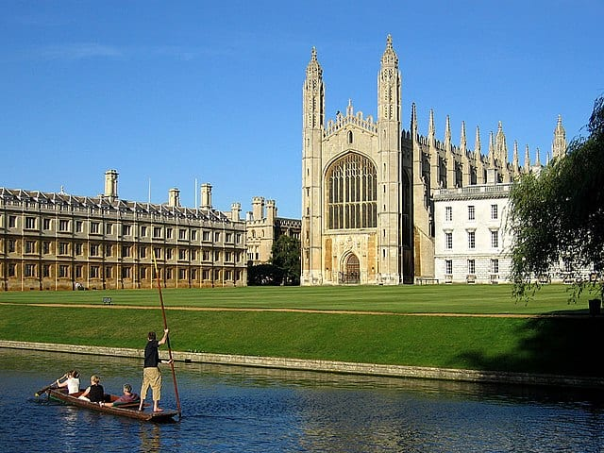
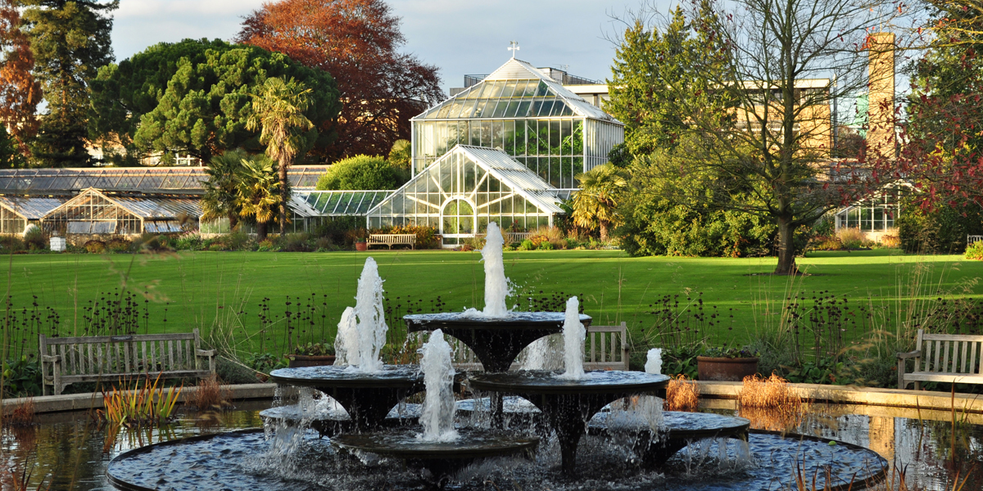
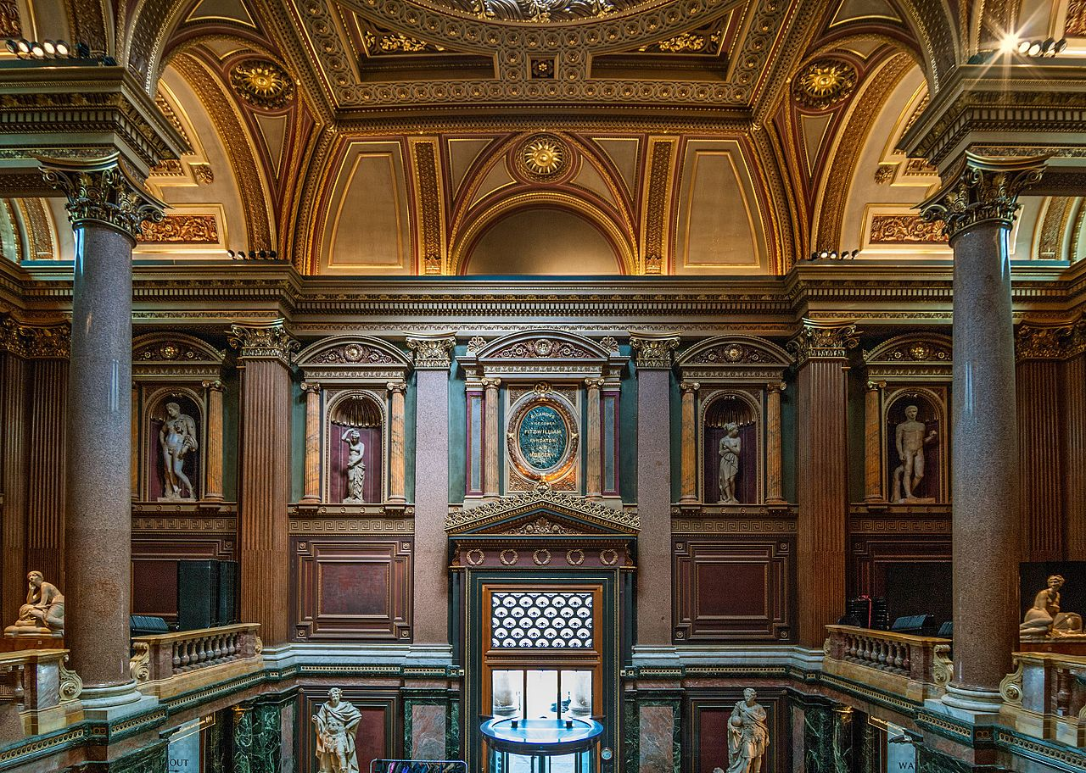
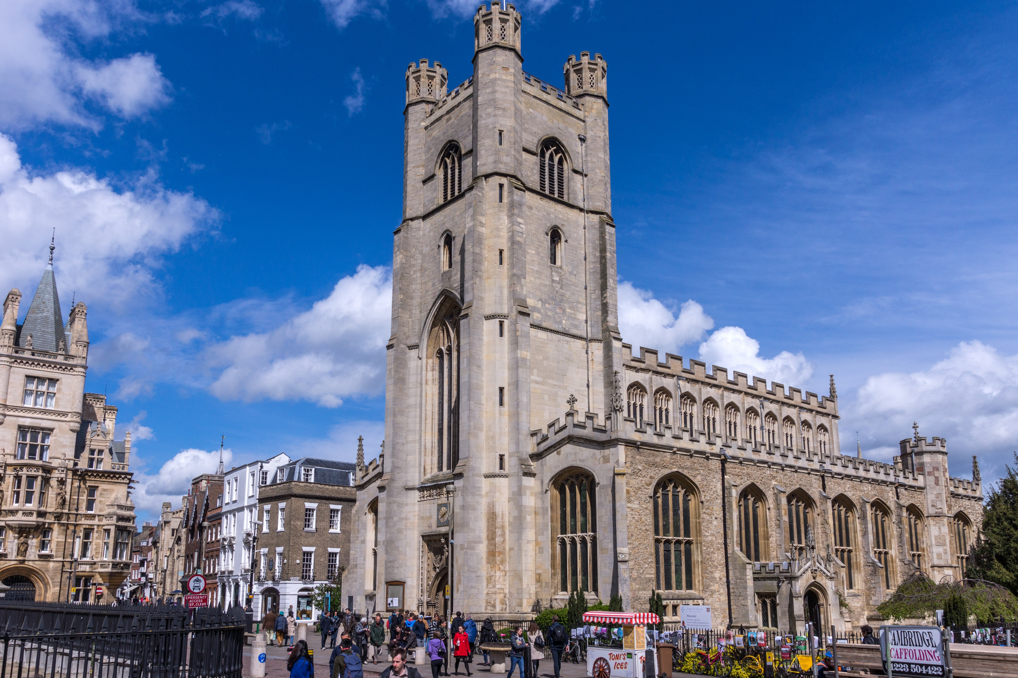
SOCIAL PROGRAMME
SEPTEMBER 2024
Every
Monday
3.25pm
Wednesday
4 Sept
15:25pm
Friday
6 & 20 Sept
13:45pm
Wednesday
11 Sept
15:15pm
Wednesday
18 Sept
15:15pm
Wednesday
25 Sept
15:25pm
Friday
27 Sept
13:45pm
Every Monday
15:25pm
Friday
13 Sept
13:45pm
Walking tour
Price: Free
Cambridge has lots to see and do including museums, colleges and shopping malls. We’re offering a walking tour every Monday which starts from the school and finishes in the city centre close to the shopping centre and bus station.
Great St Mary’s
Price: 7
If you don’t have a fear of heights, we recommend climbing the 123 steps of the spiral staircase to see the magnificent views of Cambridge including The Backs, the daily market and a particularly spectacular one of King’s College Chapel.
Punting
Price: £20
The Cambridge experience is not complete if it doesn’t include punting on the river Cam. You get to see the amazing Colleges from The Backs and take nice pictures to immortalise this experience. If you want to sign up, please come to reception!
Fitzwilliam Museum
Price: Free
This is Cambridge’s largest museum which houses amazing artefacts and art from around the world. Highlights include Egyptian coffins, impressionist masterpieces and Renaissance sculpture. Sign up early
King’s College
Price: 15
A popular tourist attractions. Completed by Henry VIII in 1544 this fine example of neo-Gothic architecture is steeped in Tudor history and symbology. You’ll be able to enjoy the biggest Chapel in the world, including some of the amazing stained glass.
Museum of Zoology
Price: Free
The Museum of Zoology is one of Cambridge's major attractions. The brilliant galleries showcase the diversity of animal life, from marsupials to monkeys, mammoths to manatees. Join us to explore this fascinating museum.
Museum of Archaeology and Anthropology
Price: Free Founded in 1884, M.A.A. houses collections of local antiquities together with archaeological and ethnographic artefacts from around the world.
Botanic Gardens
Price: £10
The Botanic Garden is one of the most impressive displays of plants and flowers that you will ever see - and it is very close to Studio Cambridge! If you want to sign up, please come to reception.

